Slide 1
SOTON-WAIS @ SED2013
Sparse Features and incremental density based clustering
Sina Samangooei

Slide 2
Social Event Detection @ Mediaeval 2013
Event clustering of multimodal social media streams
Specifically:
Given 500k Flickr images with
image, tags, (some) geo, (some) time taken, time posted etc.
Cluster into “events”

Slide 3
Social Events
We define social events as events that are planned by people, attended by people and the media illustrating the events are captured by people

Slide 4
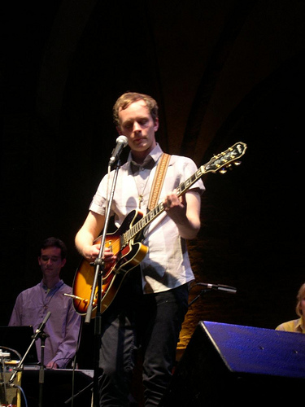

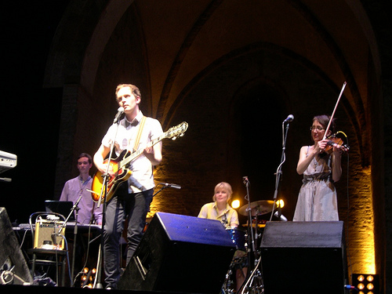
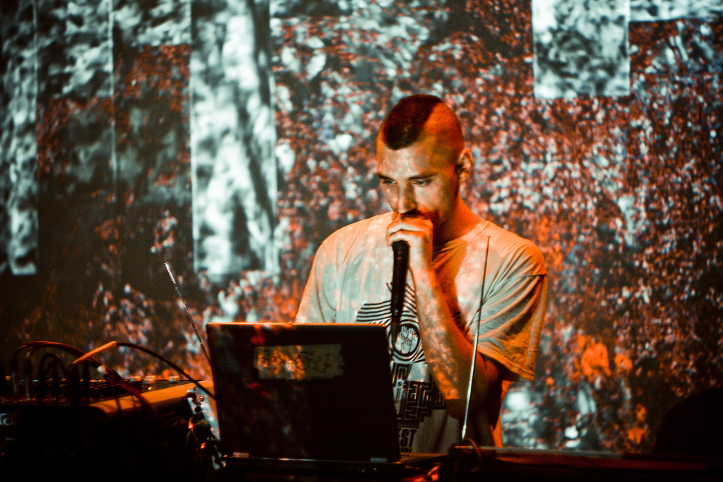
SED2013 Examples
<photo id="4302746429" photo_url="http://farm5.staticflickr.com/4068/4302746429_f8cd7f2582.jpg" username="at the foot of the hill" dateTaken="2010-01-23 21:36:05.0" dateUploaded="2010-01-25 10:43:34.0">
<title>Poo, Dead Voices on Air @ A4</title>
<description>whole set ...</description>
<tags>
<tag>2/58</tag>
<tag>58mm</tag>
<tag>concert</tag>
<tag>f2</tag>
<tag>Poo</tag>
</tags>
</photo>
<photo id="2280060852" photo_url="http://farm3.staticflickr.com/2110/2280060852_16539f5f0d.jpg" username="Pilot_10" dateTaken="2008-02-19 23:34:09.0" dateUploaded="2008-02-20 18:39:50.0">
<title>Jens Lekman @ Teatro Rasi, Ravenna</title>
<description>19 febbraio 2008</description>
<tags>
<tag>All rights reserved</tag>
<tag>concerti</tag>
<tag>coolpix_4300</tag>
<tag>emiliaromagna</tag>
</tags>
<location latitude="44.4153" longitude="12.2052"></location>
</photo>

Slide 5
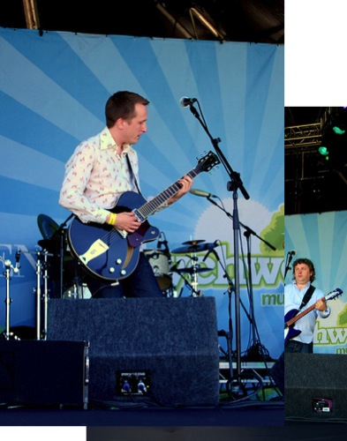
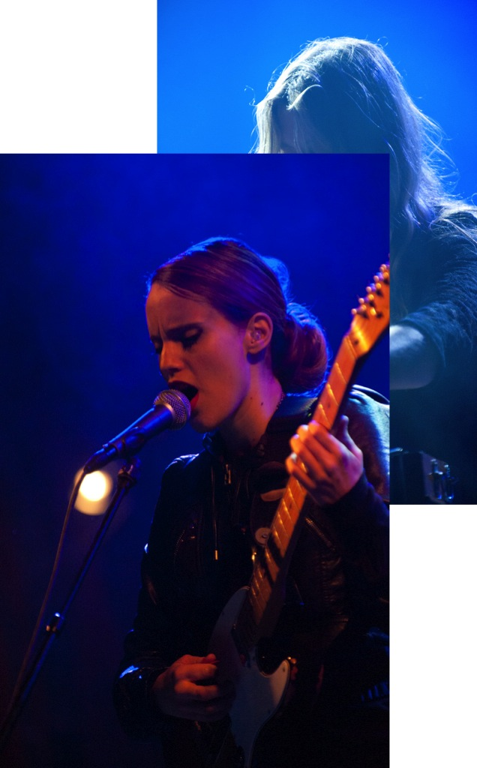
Build Sparse Matrix
Cluster

Slide 6
Features
Events potentially separable using:
Images: should look similar?
Time: should be temporally close?
Location: should be geographically close?
Text: should be described similarly?
Our social media stream contains:
Time taken (potentially inaccurate)
Time posted (accurate, though may be event agnostic)
Geo (often inaccurate, sparse)
Tags, title, description(multi-tag, spelling etc.)

Slide 7

Event Separation with Features
January 2007 until February 2007
Random color assigned to clusters

Slide 8
Event Separation with Features
Events like this could easily be confused

Slide 9
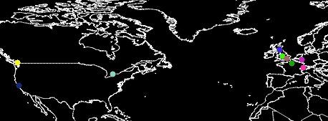
Event Separation with Features
More may help separate events

Slide 10
Feature weights
The features matter for different reasons
Some are more important than others
This is a feature fusion problem
Experiments with feature weights against cluster quality
Time taken is apparently most important
Time posted + geo seem to hold the same information
Tags beat titles and descriptions

Slide 11
Enforce Sparsity
Use a query a Lucene index to get a subset of similar images
Distance measures of Time and Geo calculated using a log decay function
force sparsity beyond certain threshold
Distance measures of tags are inherently sparse
TFIDF

Slide 12
Clustering – Finding Events
Challenges
The baseline is it self noisy
Hard to know if we’re doing well!
The task is ill posed (is Christmas an event? Are all Christmases an event? application specific)
Cluster number hard to estimate
A parameter in many clustering algorithms
Many noise points
2% clusters with 1 member
Long tail of cluster membership

Slide 14
SED2013 – DBSCAN
….the little baseline that could…
DBSCAN is an old, well studied clustering algorithm
Detects clusters and identify noise
No knowledge of cluster count needed
Requirements:
Neighborhood function (e.g. thresholded sparse similarity matrix)
Neighborhood density counts

Slide 15
SED2013 - Spectral Clustering
Theoretically appealing non-parametric clustering algorithm
Rooted in graph theory
Potentially auto detects cluster count
Basic premise is:
Use the smallest (near zero) eigenvalued eigenvectors of the graph laplacian of the similarity matrix of some data as a space within which to apply another clustering algorithm

Slide 16
SED2013 – Incremental Clustering
Practical restrictions of spectral clustering mean we can’t apply it to the whole dataset
Make an assumption about the data style
images likely to be clustered together will appear sequentially in terms of upload time
Leverage this to cluster sub windows of data
Grow the window and see if a cluster changes
If not, tag those items as clustered, and remove them

Slide 17
Results!

Slide 18
Results!
All configurations using incremental clustering

Slide 19
Results!
Time Taken matters most!

Slide 20
Weights MAtter!
They matter quite a lot

